Slide 1
EVOLUTION OF THE INTERNET

Slide 2
WHAT IS THE INTERNET?
THE INTERNET IS A GLOBAL NETWORK OF BILLIONS OF COMPUTERS AND OTHER ELECTRONIC DEVICES. WITH THE INTERNET, IT'S POSSIBLE TO ACCESS ALMOST ANY INFORMATION, COMMUNICATE WITH ANYONE ELSE IN THE WORLD, AND DO MUCH MORE.

Slide 3
WHEN DID IT BEGAN?
THE INTERNET STARTED IN THE 1960S AS A WAY FOR GOVERNMENT RESEARCHERS TO SHARE INFORMATION. COMPUTERS IN THE '60S WERE LARGE AND IMMOBILE AND IN ORDER TO MAKE USE OF INFORMATION STORED IN ANY ONE COMPUTER, ONE HAD TO EITHER TRAVEL TO THE SITE OF THE COMPUTER OR HAVE MAGNETIC COMPUTER TAPES SENT THROUGH THE CONVENTIONAL POSTAL SYSTEM.

Slide 4
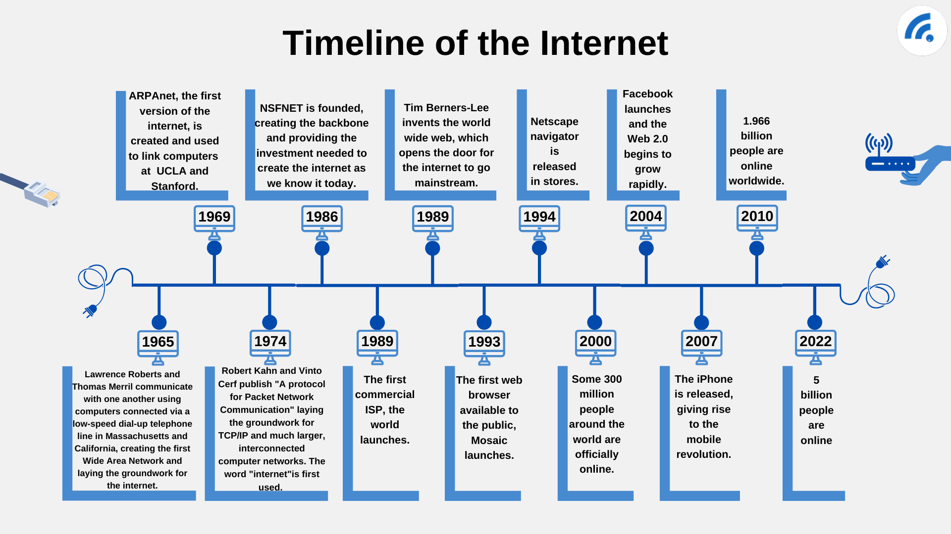
EVOLUTION

Slide 5
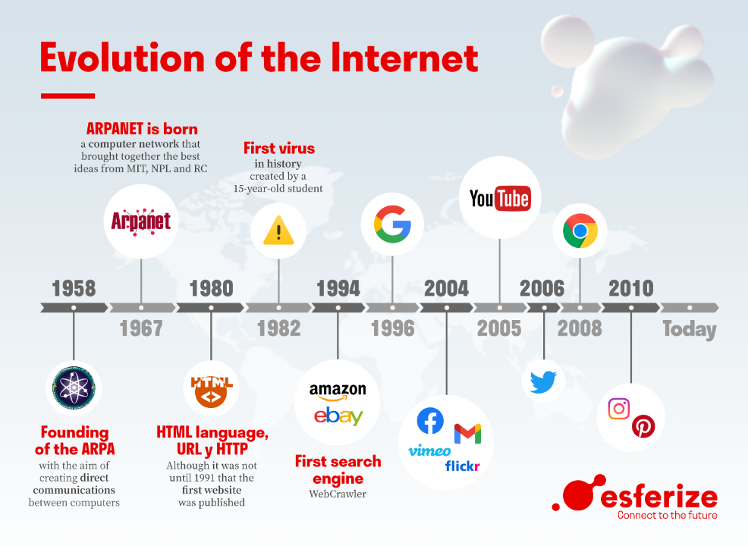

Slide 6
THE END.

